Slide 1
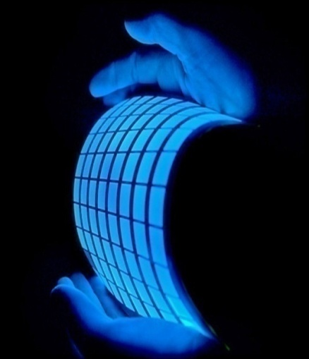
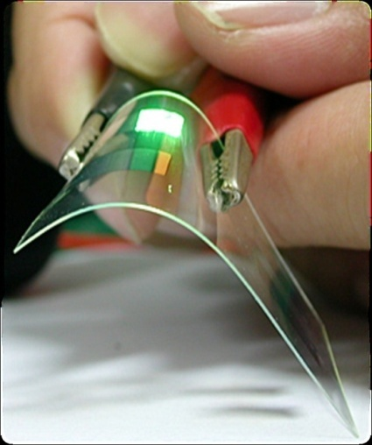
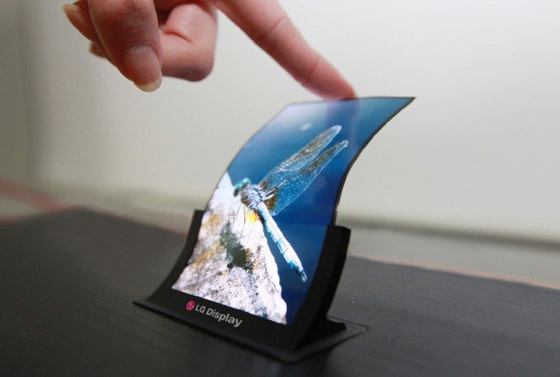
Organic LIGHT EMITTING DIODE
(OLED)
Dr. S. RANJITH / Physics, SRM IST

Slide 2
CONTENT
Introduction
Structure of OLEDs
Working principle of OLEDs
Types of OLEDs
Advantage and Disadvantage of OLEDs
Upcoming future of OLEDs
Current Research on OLEDs
Dr. S. RANJITH / Physics, SRM IST

Slide 3
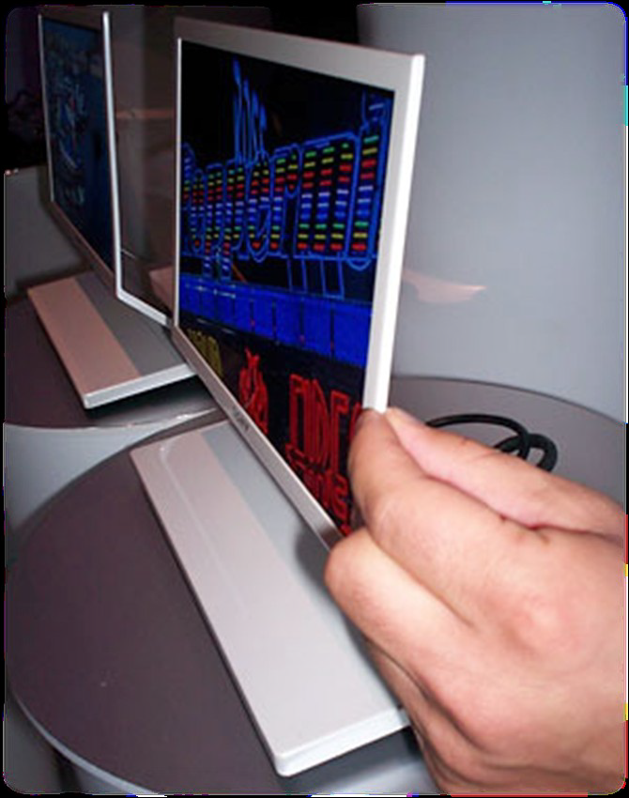
INTRODUCTION
WHAT IS AN OLED ?
OLED is solid state semiconductor device composed of thin films of organic molecules that creates Light with the application of electricity.
A device that is 100 to 500 nanometers thick or about 200 times smaller than a human hair.
It can be thinner and weight less than other display technologies.
It have a wide view angle(up to 160 degrees even in bright light).
It uses less power than conventional LEDs or LCDs display.
Dr. S. RANJITH / Physics, SRM IST

Slide 4
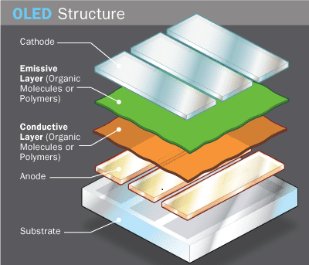
OLED STRUCTURE AND ARCHITECTURE
SUBSTRATE: (clear plastic or glass foil) The substrate Supports the OLED.
ANODE : Adds electron when current flows through OLED
CATHODE: Injects electrons when current flows through OLED.
ORGANIC LAYER: Organic molecules or polymers.
CONDUCTING LAYER: This layer is made of organic plastic molecules that transport “holes” from the anode. polyaniline is used as conducting layer.
EMISSIVE LAYER: This layer is made of organic plastic molecules that transport “electron” from the cathode. polyfluorene is used as conducting layer.
Dr. S. RANJITH / Physics, SRM IST

Slide 5
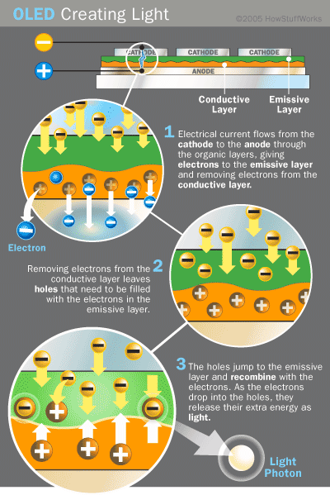
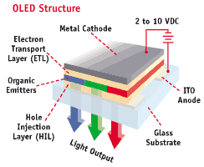
HOW OLED WORK ?
When a voltage is applied to OLED, the holes and the electrons are generated from each of the two electrodes, which have a positive and negative electric charge respectively.
When they recombine in the emissive layer, organic materials make the emissive layer to turn into a high energy state termed “excitation”.
The light is emitted when the layer returns to its original stability
Dr. S. RANJITH / Physics, SRM IST

Slide 6
WHY OLED?
Lighting efficiency
  LEDs (ordinary light emitting diodes) are bright points; not versatile
  OLEDs may be better on all counts
Displays: Significant advantages over liquid crystals
  Faster
  Brighter
  Lower power
Cost and design
  LEDs are crystals; LCDs are highly structured;
  OLEDs are not –Malleable; can be bent, rolled up, etc.
  Easier to fabricate
TYPES OF OLEDs
Passive-matrix OLED
Active-matrix OLED
Transparent OLED
Top-emitting OLED
Foldable OLED
White OLED
Dr. S. RANJITH / Physics, SRM IST

Slide 7
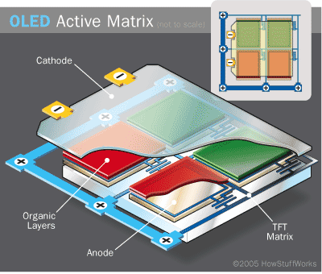
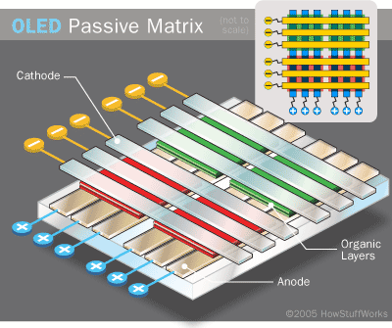
Active-Matrix OLED
Passive-Matrix OLED
Full layers of cathode, anode, organic molecules
Thin Film Transistor matrix (TFT) on top of anode
  Internal circuitry to determine which pixels to turn on/off
Less power consumed then PMOLED
  Used for larger displays
Perpendicular cathode/anode strip orientation
Light emitted at intersection (pixels)
External circuitry
  Turns on/off pixels
Large power consumption
  Used on 1-3 inch screens
  Alphanumeric displays
Dr. S. RANJITH / Physics, SRM IST

Slide 8


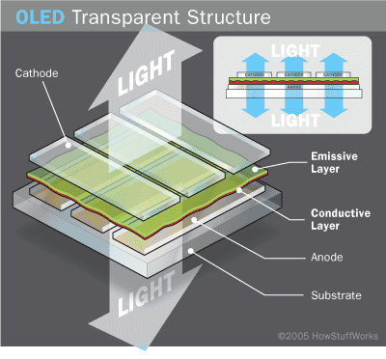
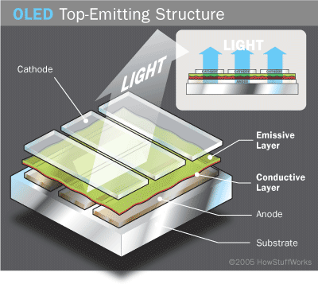
Transparent OLED
Top-emitting OLED
Transparent substrate, cathode and anode.
Bi-direction light emission.
Passive or Active Matrix OLED.
Useful for heads-up display
  Transparent projector screen
  glasses
Non-transparent or reflective substrate.
Transparent Cathode.
Used with Active Matrix Device.
Smart card displays.
Dr. S. RANJITH / Physics, SRM IST

Slide 9
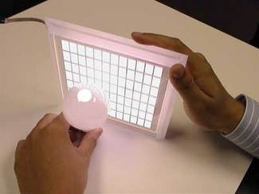
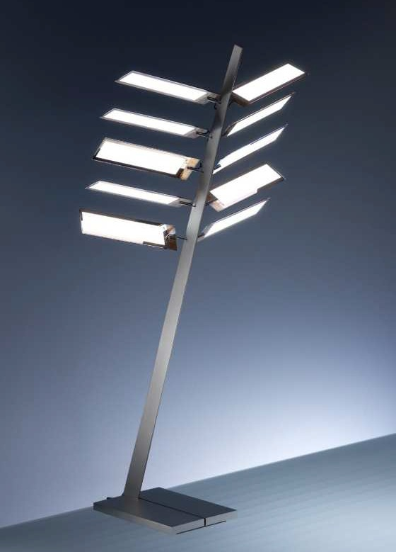
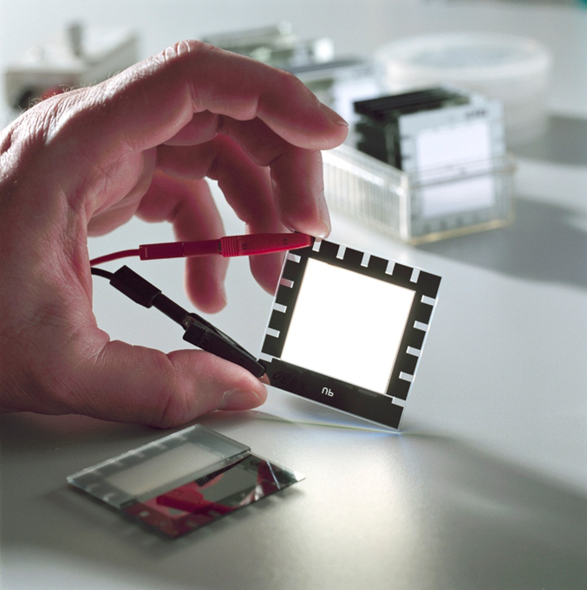
IN FUTURE OLED IS USED AS LIGHTING SOURCE :-
Emits bright white light
Replace fluorescent lights
Reduce energy cost for lighting
True Color Qualities
Dr. S. RANJITH / Physics, SRM IST

Slide 10
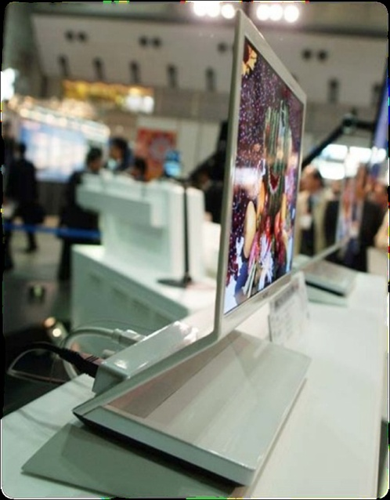
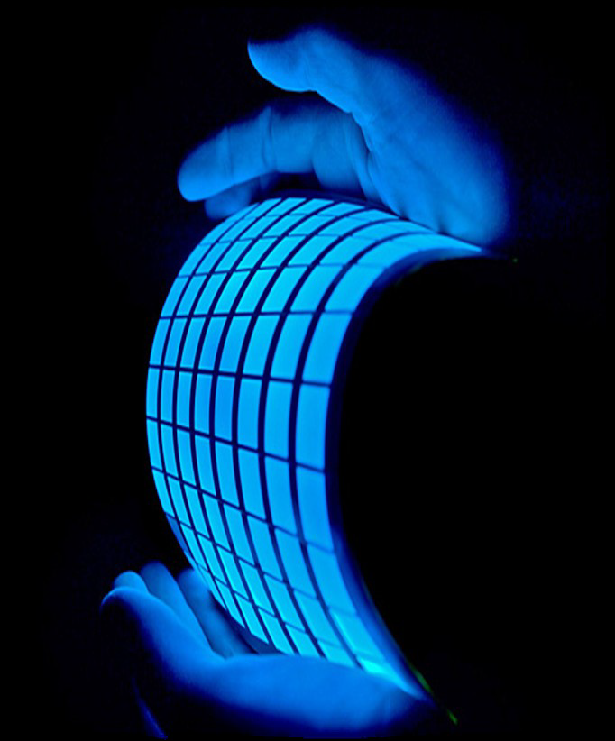

FOLDABLE OLEDs
Plastic, organic layers of an OLED are thinner ,lighter and more flexible than crystalline layers of LEDs and LCDs.
Brighter display than LEDs due to thinner organic layers.
Do not require backlighting like LCDs.
Consume much less power , important for battery-operated
devices.
Easier to produce in larger sizes.
Have large fields of view about 160 degrees.
Dr. S. RANJITH / Physics, SRM IST

Slide 11
Advantages
Disadvantages
Thinner, lighter and more flexible
Brighter
Consume much less power
Easier to produce and make into larger sizes
Large field of view
Lifetime
  White, Red, Green → 46,000-230,000 hours
    About 5-25 years
  Blue → 14,000 hours
    About 1.6 years
Expensive
Susceptible to water
Overcome multi-billion dollar LCD market
Dr. S. RANJITH / Physics, SRM IST

Slide 12
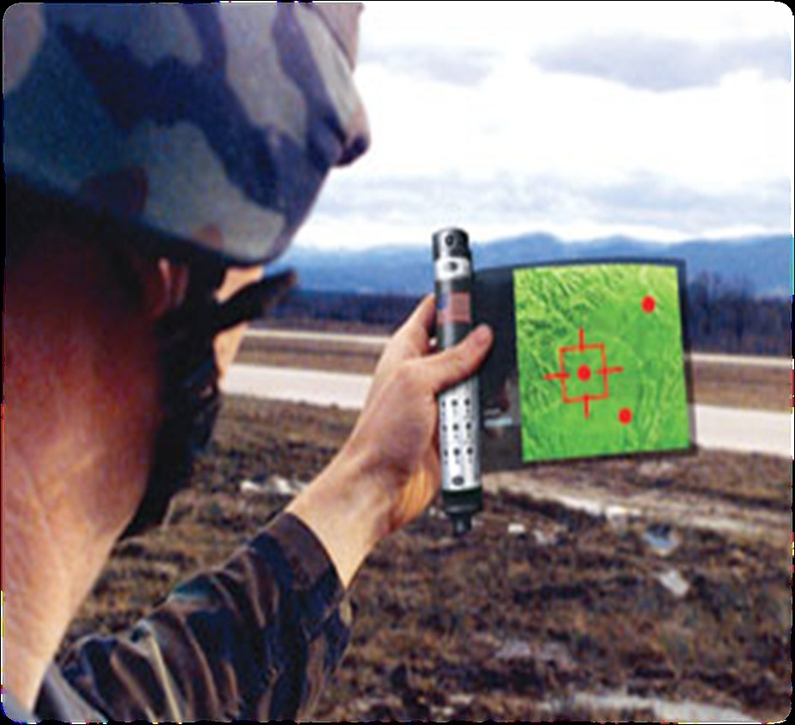
UPCOMING FUTUREs OF OLEDs…
An OLED display newspaper that
refreshes with breaking news.
An OLED sewn “smart clothing” that could be a source of unending
entertainment.
An OLED embedded ornaments that could entertain the folk.
An OLED based digital map and GPS that could help the armed forces during military operations.
Dr. S. RANJITH / Physics, SRM IST

